Slide 1
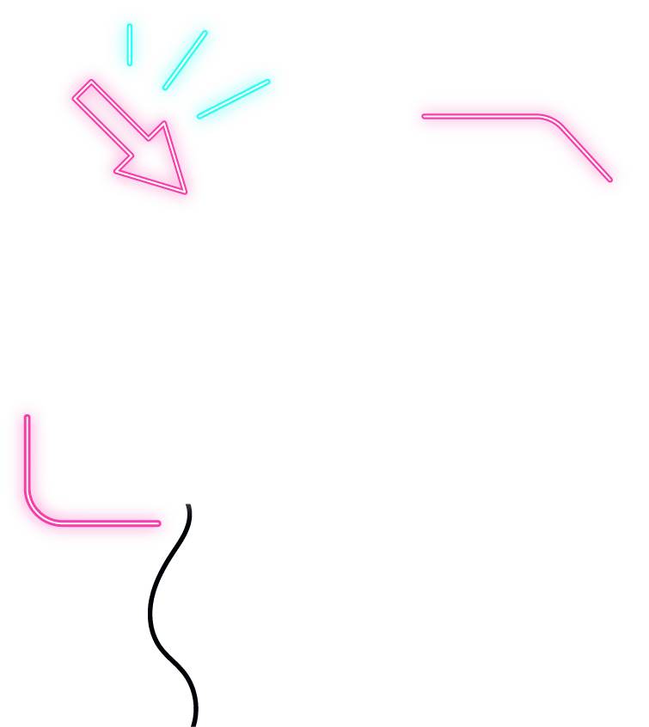






IOT WORKLOAD CHARACTERIZATION IN NEXT GENERATION CLOUD SYSTEMS UPDATE
Supervised by: Dr. Karan Mitra, Dr. Saguna Saguna,
Dr. Christer Åhlund
Presented by: Fatema Mirza

Slide 2






Queueing Model
TABLE OF CONTENTS
T-drive dataset
Findings
Queueing Model for IoT-Cloud for Markov Model
Different types of Distribution
fatmir-0@student.ltu.se

Slide 3
01
Queueing Model
fatmir-0@student.ltu.se

Slide 4
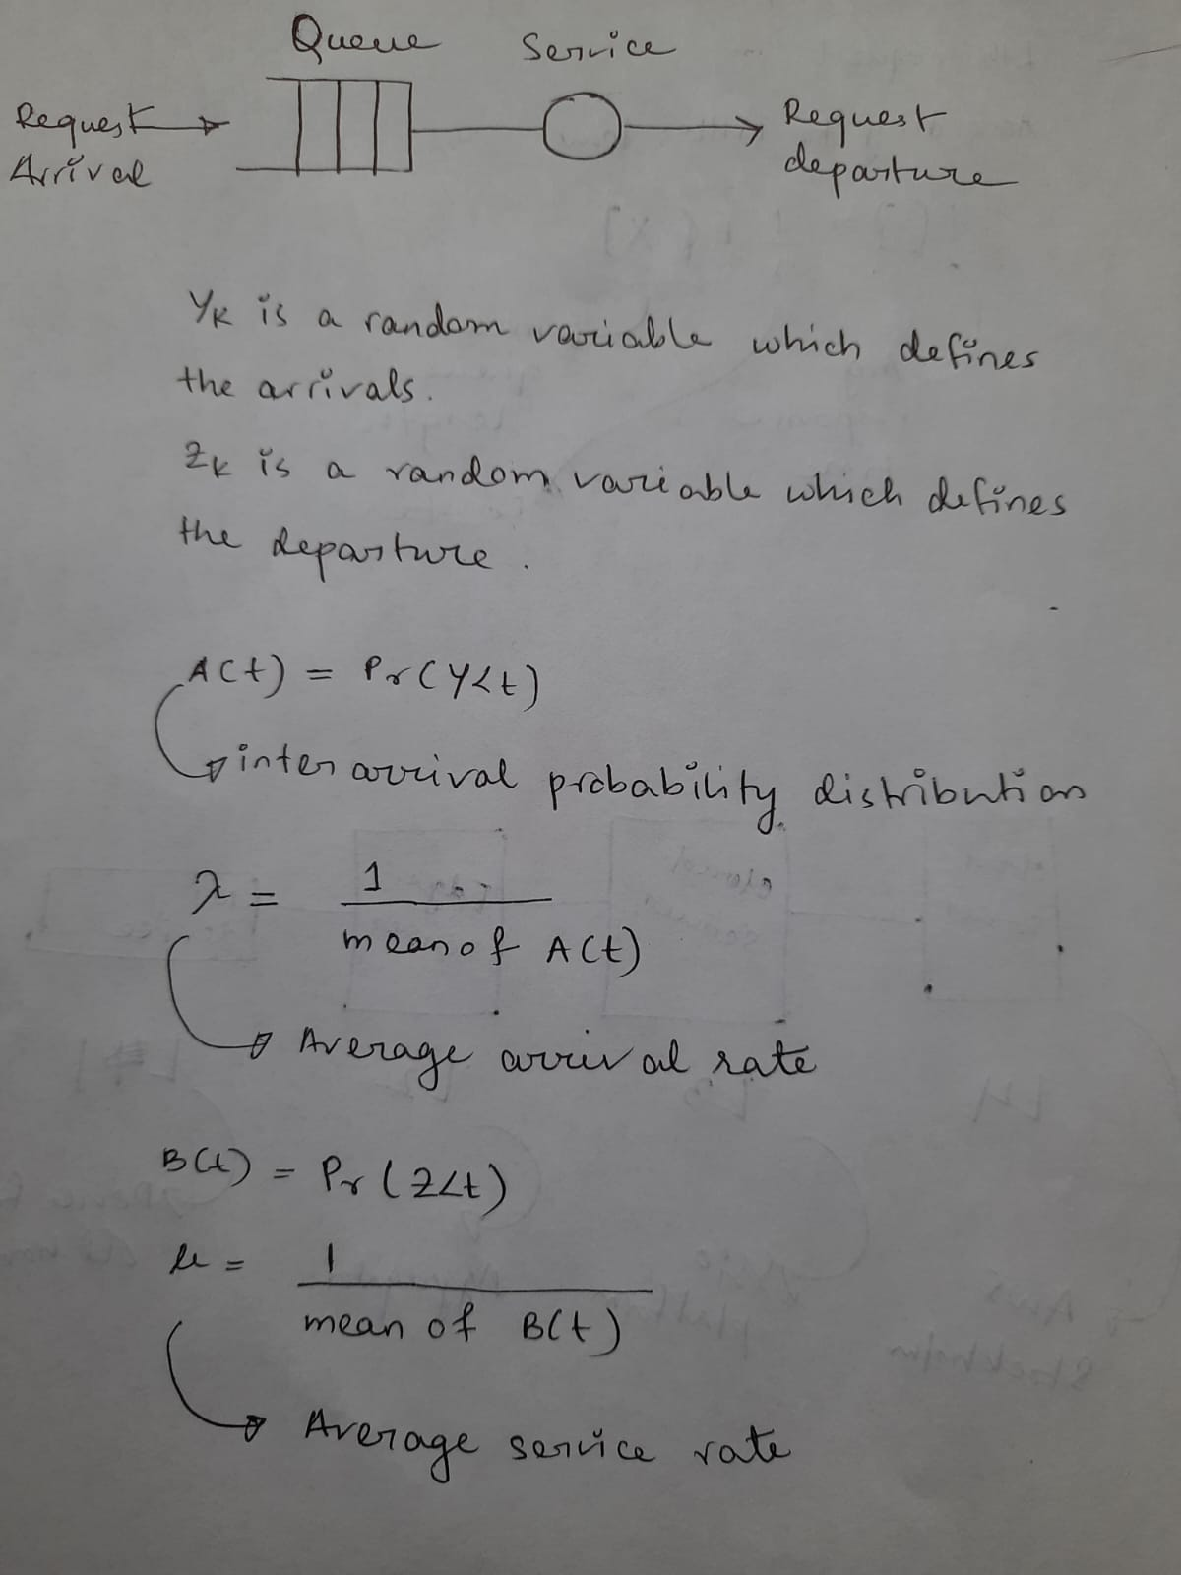
Queue Model Introduction^{[1]}
fatmir-0@student.ltu.se 26/01/2022 | 01

Slide 5

Little’s Law^{[2]}
Little's Law says that, under steady state conditions, the average number of items in a queuing system equals the average rate at which items arrive multiplied by the average time that an item spends in the system.
fatmir-0@student.ltu.se 26/01/2022 | 02

Slide 6
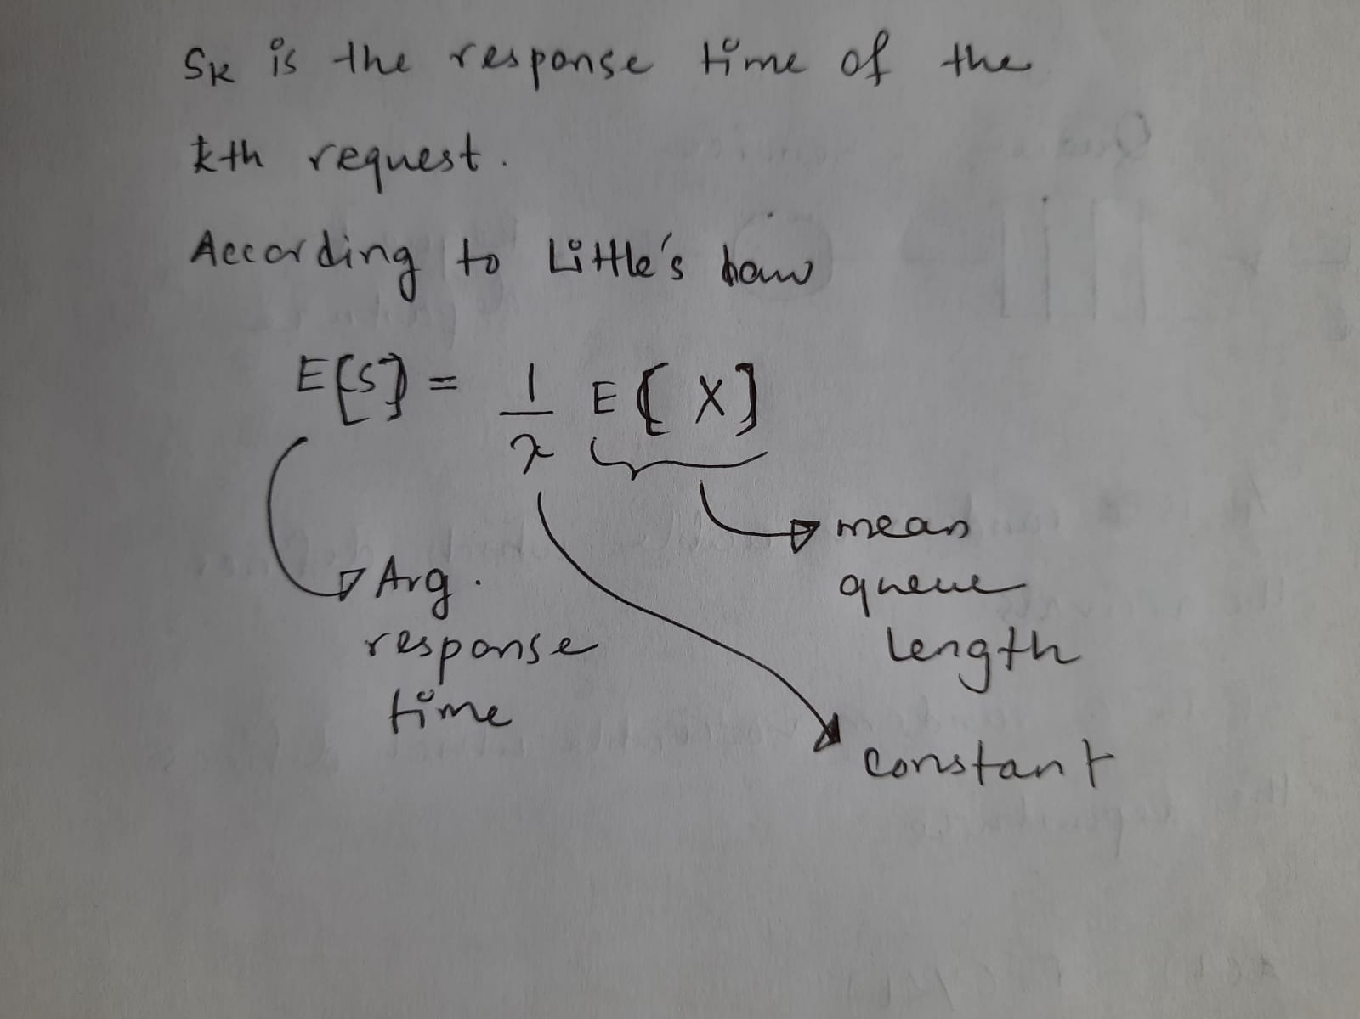
Average Response Time
fatmir-0@student.ltu.se 26/01/2022 | 03

Slide 7
02
Queueing Model for IoT-Cloud for Markov Model
fatmir-0@student.ltu.se

Slide 8
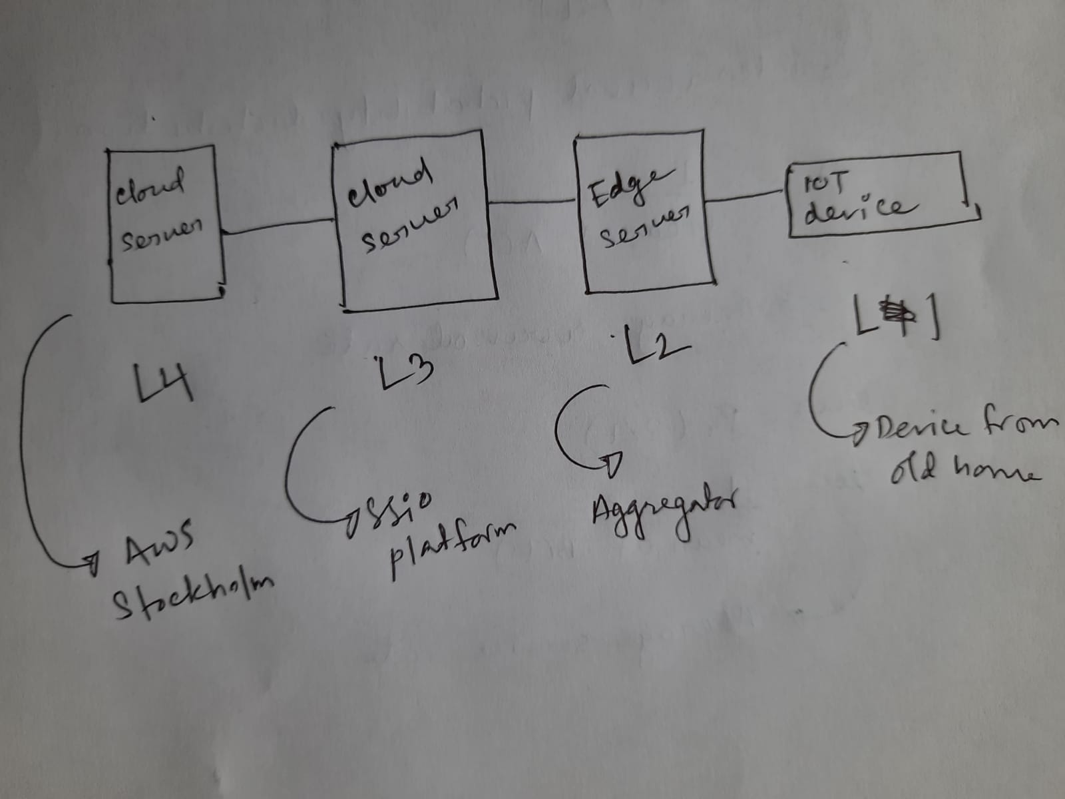
Hypothesized Model for IoT-Cloud
fatmir-0@student.ltu.se 26/01/2022 | 04

Slide 9
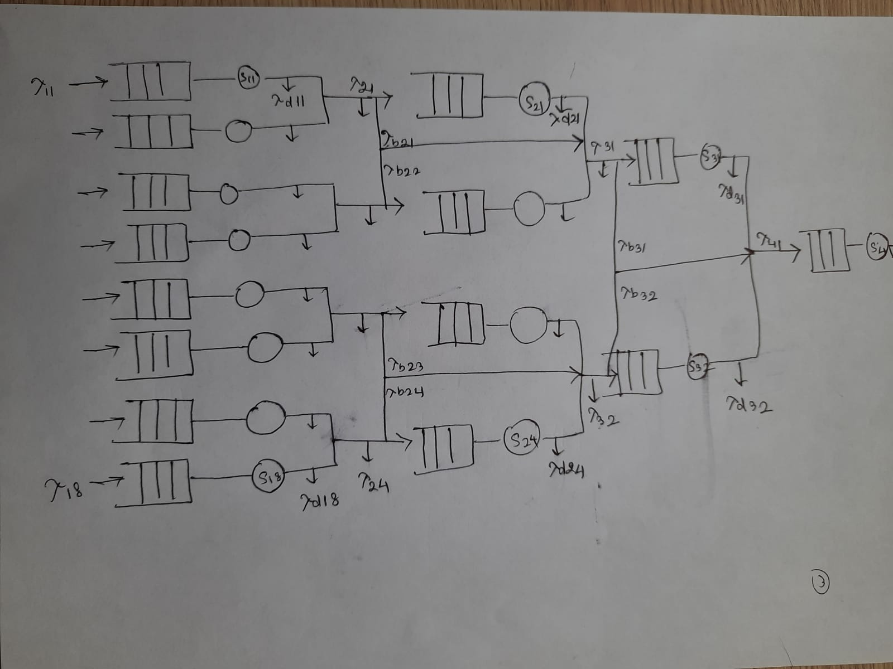
Queueing model for IoT-Cloud
fatmir-0@student.ltu.se 26/01/2022 | 05

Slide 10
Burke Theorem^{[3]}
Burke’s theorem is a well-known fundamental result in queueing theory, stating that a stationary M/M/1 queue has a departure process that is identical in law to the arrival process and, moreover, for each time t, the following three random objects are independent: the queue length at time t, the arrival process after t and the departure process before t.
fatmir-0@student.ltu.se 26/01/2022 | 06

Slide 11
Jacksonian Network^{[4]}
In queueing theory, a discipline within the mathematical theory of probability, a Jackson network (sometimes Jacksonian network) is a class of queueing network where the equilibrium distribution is particularly simple to compute as the network has a product-form solution.
fatmir-0@student.ltu.se 26/01/2022 | 07

Slide 12
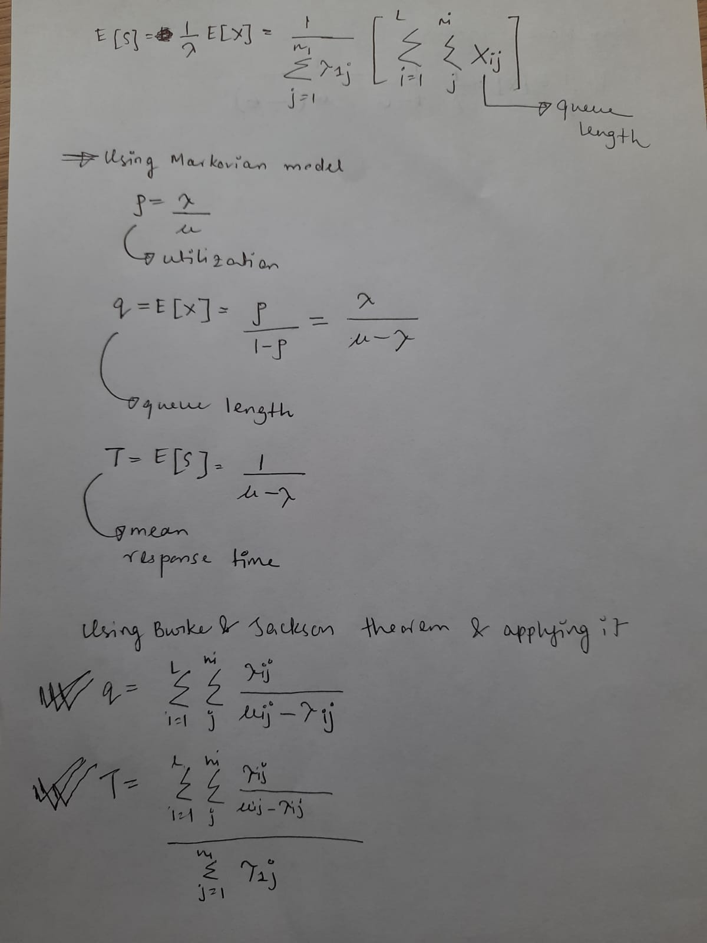
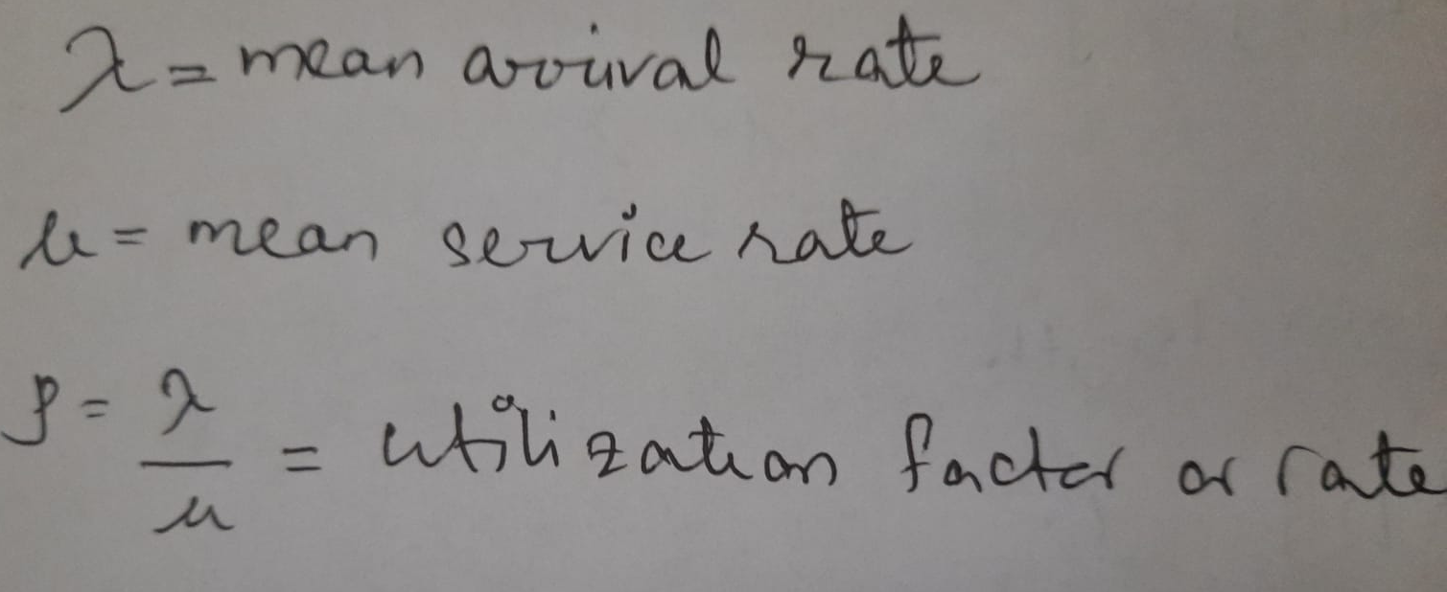
Average Response Time & queue time w.r.t queue models
fatmir-0@student.ltu.se 26/01/2022 | 08

Slide 13

Working on semi markovian model …
fatmir-0@student.ltu.se

Slide 14
What is semi markovian model?
Where IOT has no memory at all and all is sent to a hub.
fatmir-0@student.ltu.se 26/01/2022 | 09

Slide 15
03
Different types of Distribution
fatmir-0@student.ltu.se

Slide 16

Weibull
Gen. Pareto
Distribution Types^{[5]}
Poisson
Light and temperature
Motion
Hypothesized aggregated data of interval times
fatmir-0@student.ltu.se 26/01/2022 | 10

Slide 17
04
T-drive dataset^{[6,7,8]}
fatmir-0@student.ltu.se

Slide 18
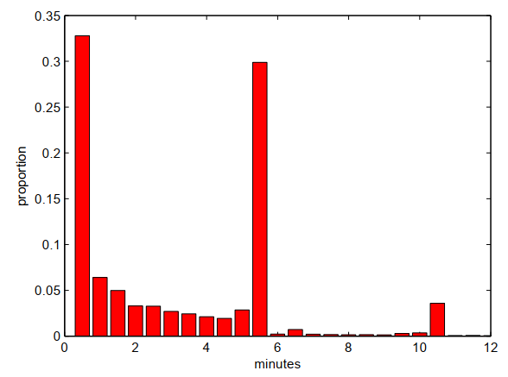
Histogram of time b/w two consecutive points
fatmir-0@student.ltu.se 26/01/2022 | 11

Slide 19
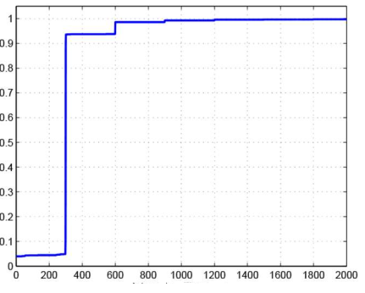
CDF for taxi 19
fatmir-0@student.ltu.se 26/01/2022 | 12
Notes:
The rapid increase in connected device (or IoT device) usage by commercial entities and consumers is changing the topography of the internet Connected devices have been designed to fulfill functional requirements (i.e. observe, control and maintain a piece of machinery remotely), but have often failed at incorporating proper green aspects in their design. The integration of the Internet of things and cloud computing has led to the emergence of new classes of applications ranging from smart healthcare, smart and precision agriculture, smart manufacturing to smart environmental monitoring. The rapid surge in the use of these applications is expected to generate massive amounts of data with different characteristics that are yet not studied.

Slide 20
05
Findings
fatmir-0@student.ltu.se

Slide 21


Findings
Find the equation for semi Markov model
Explore the dataset with E, GE, P, GP, LN, G, WB and then check with KS mean and variance and find the lowest with original one.
Explore more about PDF and CDF (already explored that PDF is the derivative of CDF)
Explore t drive dataset with E, GE, P, GP, LN, G, WB and then check with KS mean and variance and find the lowest with original one.
Do EDA on the real data
Read more of Performance Modeling and
Analysis of Communication Networks^{[9]}
Finish this by 10 Feb
fatmir-0@student.ltu.se 26/01/2022 | 13

Slide 22

Thank you! Tack så mycket
Any Questions?
fatmir-0@student.ltu.se

Slide 23
References
[1] https://www.youtube.com/watch?v=SqSUJ0UYWMQ
[2] https://techcrunch.com/2014/11/08/littles-law-is-big-for-startups/?guccounter=1&guce_referrer=aHR0cHM6Ly93d3cuZ29vZ2xlLmNvbS8&guce_referrer_sig=AQAAAFvY4BNr5Vvu2uDhXO4VTDuLiVSsISoGSjMxJMxW1Pt6ar11_kEY1wq5aw5HlXlySpE0jUAVwaZrqBu00JlSq7EUCeucjIMrTrHpRp59P000WKfozg64v5gANPPBZ1cB1W72iB8KG7aZ9xlUhU3E68QBMT2CsMngoCUV5UZ2HcNW
[3] Konstantopoulos, T. A review of Burke’s theorem for Brownian motion. Queueing Syst 83, 1–12 (2016). https://doi.org/10.1007/s11134-016-9478-x
[4] Chen H., Yao D.D. (2001) Jackson Networks. In: Fundamentals of Queueing Networks. Stochastic Modelling and Applied Probability, vol 46. Springer, New York, NY. https://doi.org/10.1007/978-1-4757-5301-1_2
[5] M. López-Benítez, C. Majumdar and S. N. Merchant, "Aggregated Traffic Models for Real-World Data in the Internet of Things," in IEEE Wireless Communications Letters, vol. 9, no. 7, pp. 1046-1050, July 2020, doi: 10.1109/LWC.2020.2980272.
[6] M. López-Benítez, C. Majumdar and S. N. Merchant, "Aggregated Traffic Models for Real-World Data in the Internet of Things," in IEEE Wireless Communications Letters, vol. 9, no. 7, pp. 1046-1050, July 2020, doi: 10.1109/LWC.2020.2980272.
[7] ing Yuan, Yu Zheng, Chengyang Zhang, Wenlei Xie, Xing Xie, Guangzhong Sun, and Yan Huang. Tdrive: driving directions based on taxi trajectories. In Proceedings of the 18th SIGSPATIAL International
Conference on Advances in Geographic Information Systems, GIS ’10, pages 99{108, New York, NY, USA,
2010. ACM.
[8] Huang, Jiwei & Li, Songyuan & Chen, Ying & Chen, Junliang. (2018). Performance modelling and analysis for IoT services. International Journal of Web and Grid Services. 14. 146. 10.1504/IJWGS.2018.090742.
[9] Tran-Gia, Phuoc & Hossfeld, Tobias (2021). Performance Modeling and Analysis of Communication Networks
- A Lecture Note. Würzburg University Press. https://doi.org/10.25972/WUP-978-3-95826-153-2
fatmir-0@student.ltu.se 17/12/2021 | 15

